Slide 1
GPR Measurement Point Selection Strategy Analysis
Synthetic & Case Study Evaluation Results

Slide 2
Table of contents
1 Synthetic Evaluation
6 Agenda/Topic
2 Case Study Evaluation
7 Agenda/Topic
3 Agenda/Topic
8 Agenda/Topic
4 Agenda/Topic
9 Agenda/Topic
5 Agenda/Topic
10 Agenda/Topic

Slide 3
Synthetic Evaluation

Slide 4
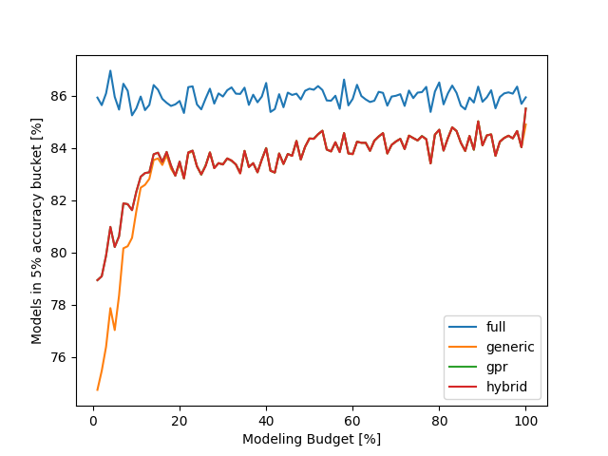
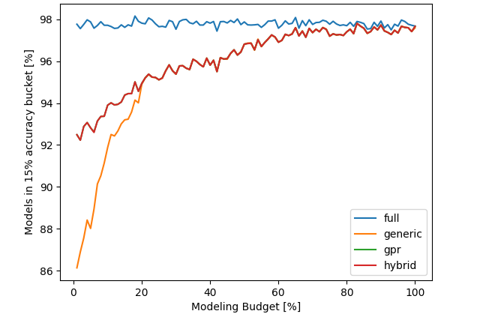
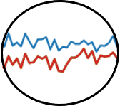
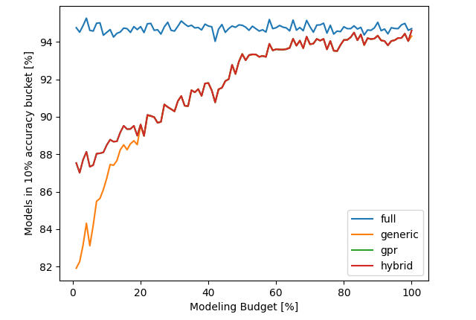
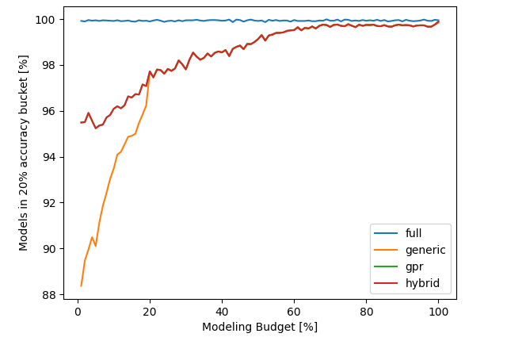
Synthetic Evaluation – Model Accuracy 2 Model Parameter & 1% Noise
The GPR, hybrid strategy outperform the generic strategy using small modeling budgets <20%
The turning point is always at about 20% modeling budget
5% Accuracy Bucket
15% Accuracy Bucket
The results look like that because the functions for each evaluation run (budget) are randomly chosen, i.e., are different, and the induced noise varies as well
The bigger the accuracy bucket, the better the model accuracy for all strategies
10% Accuracy Bucket
20% Accuracy Bucket
The bigger the accuracy bucket, the more the GPR, hybrid strategy outperforms the generic strategy
For this experiment, the GPR and hybrid strategy perform almost identically

Slide 5
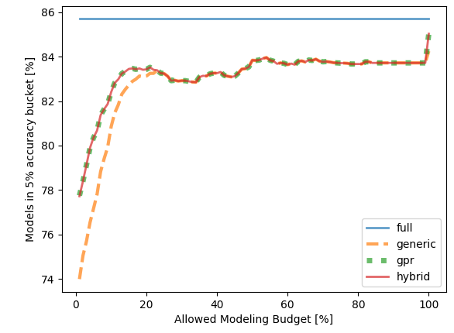
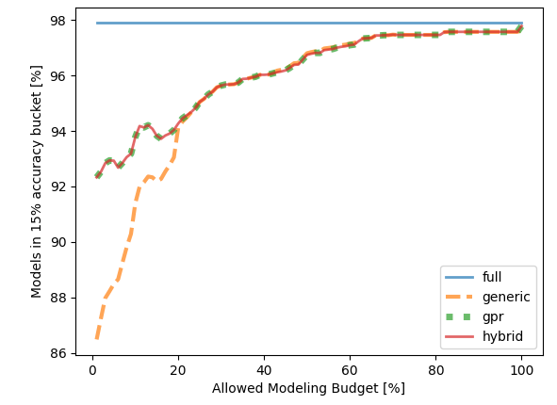
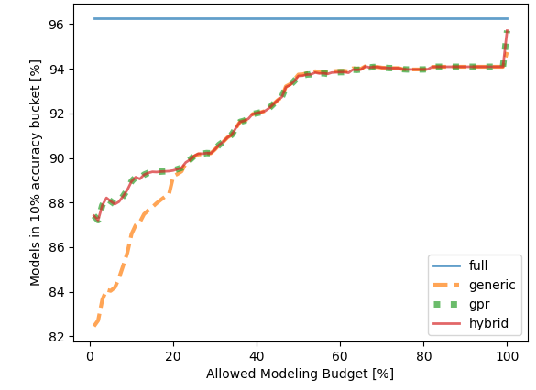
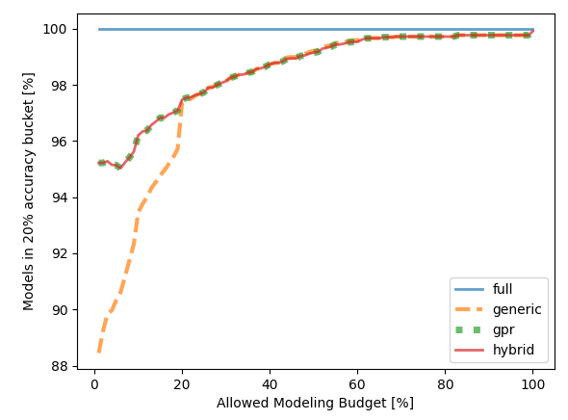
Synthetic Evaluation – Model Accuracy 2 Model Parameter & 1% Noise
The GPR, hybrid strategy outperform the generic strategy using small modeling budgets <20%
The turning point is always at about 20% modeling budget
5% Accuracy Bucket
15% Accuracy Bucket
The bigger the accuracy bucket, the better the model accuracy for all strategies
10% Accuracy Bucket
20% Accuracy Bucket
For more than 25% budget the gpr, generic, and hybrid strategy perform identically
The bigger the accuracy bucket, the more the GPR, hybrid strategy outperforms the generic strategy

Slide 6
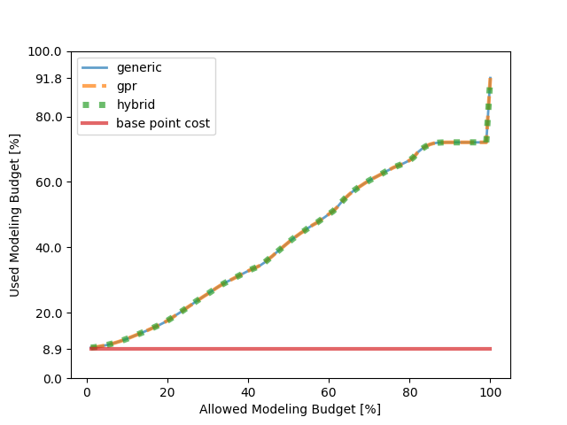
Synthetic Evaluation – Model Cost 2 Model Parameter & 1% Noise
The GPR, hybrid strategy always use the same model cost as the genneric strategy

Slide 7
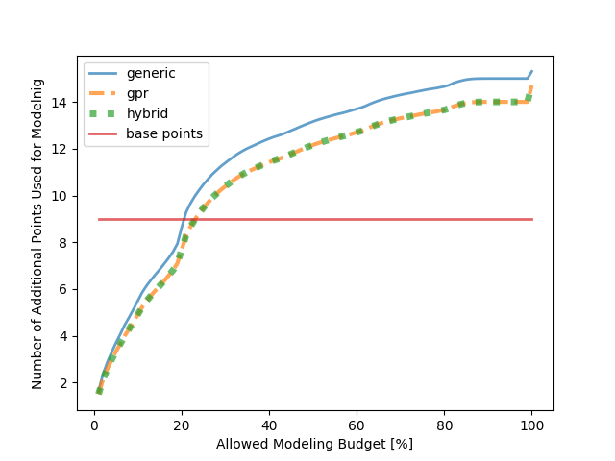
Synthetic Evaluation – Selected Points 2 Model Parameter & 1% Noise
The generic strategy uses consistently more measurement points than the GPR, hybrid strategy for all budget levels
The GPR an hybrid approach use the same amount of additional points for modeling
Considering the used budget, the GPR, hybrid strategy use less but more expensive points
The more expensive points provide better insights, which leads to a higher model accuracy

Slide 8
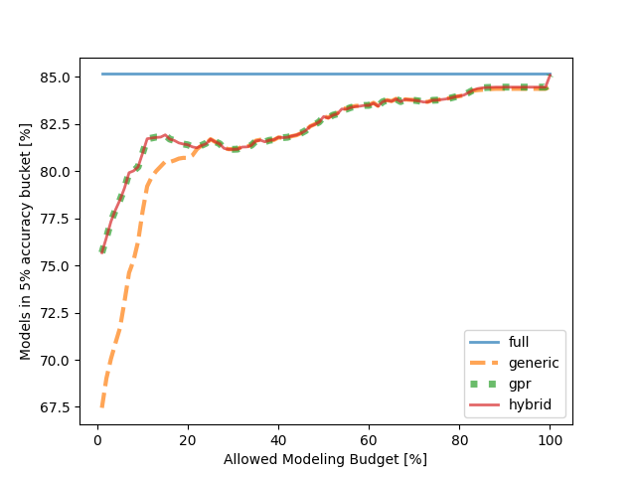
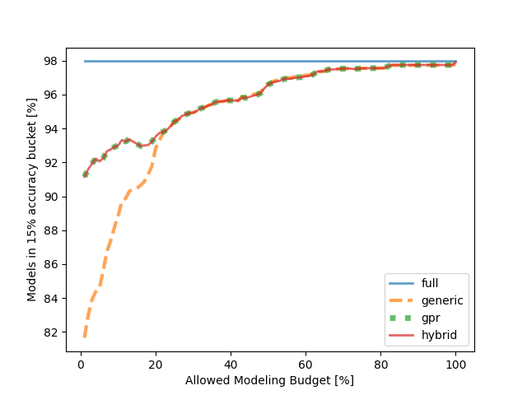
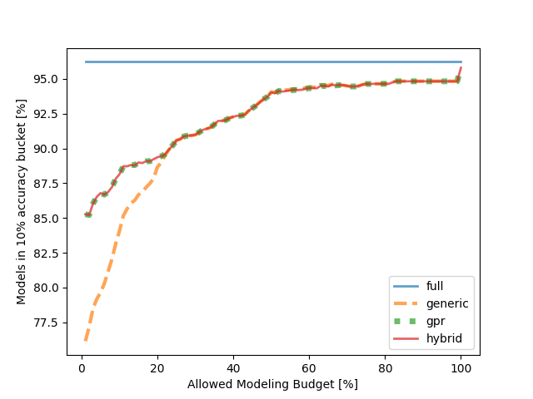
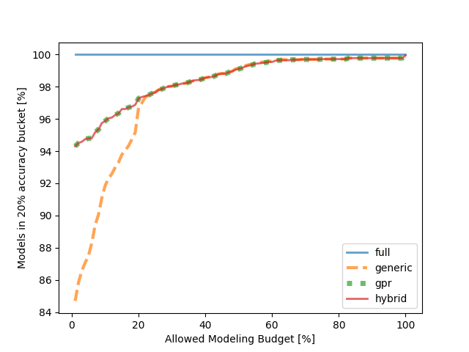
Synthetic Evaluation – Model Accuracy 2 Model Parameter & 2% Noise
The GPR, hybrid strategy outperform the generic strategy using small modeling budgets <20%
The turning point is always at about 20% modeling budget
5% Accuracy Bucket
15% Accuracy Bucket
The bigger the accuracy bucket, the better the model accuracy for all strategies
10% Accuracy Bucket
20% Accuracy Bucket
For more than 25% budget the gpr, generic, and hybrid strategy perform identically
The bigger the accuracy bucket, the more the GPR, hybrid strategy outperforms the generic strategy

Slide 9

Synthetic Evaluation – Model Cost 2 Model Parameter & 2% Noise
The GPR, hybrid strategy always use the same model cost as the genneric strategy

Slide 10
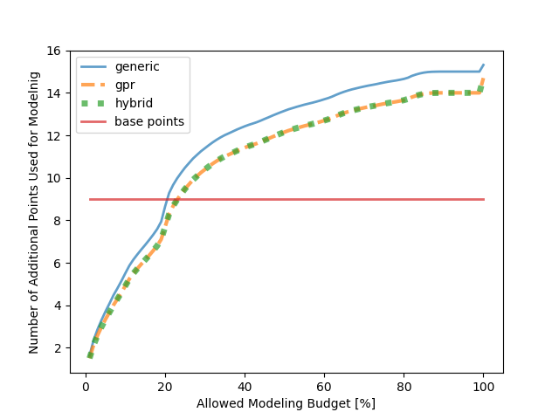
Synthetic Evaluation – Selected Points 2 Model Parameter & 2% Noise
The generic strategy uses consistently more measurement points than the GPR, hybrid strategy for all budget levels
The GPR an hybrid approach use the same amount of additional points for modeling
Considering the used budget, the GPR, hybrid strategy use less but more expensive points
The more expensive points provide better insights, which leads to a higher model accuracy

Slide 11
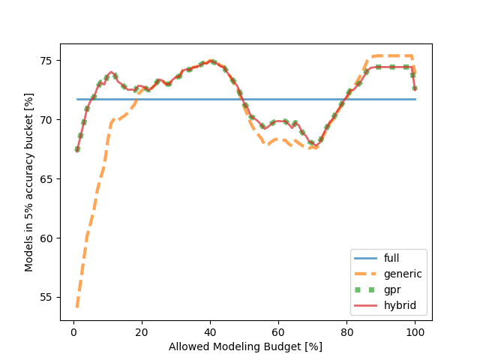
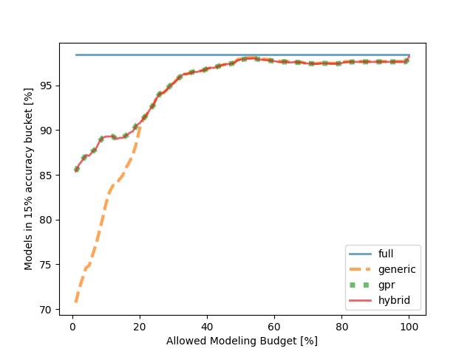
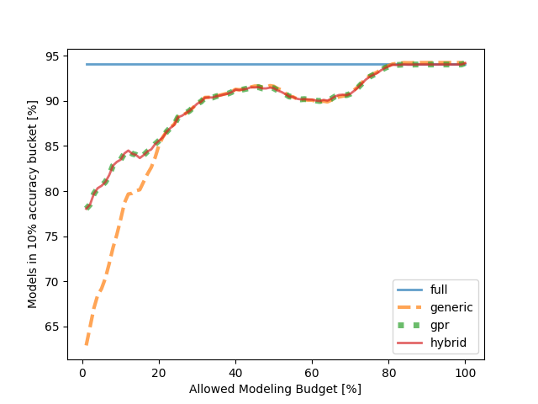
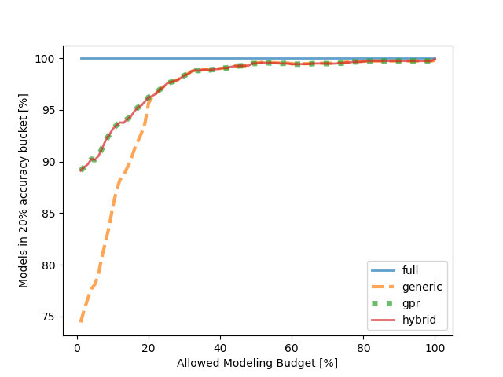
Synthetic Evaluation – Model Accuracy 2 Model Parameter & 5% Noise
The GPR, hybrid strategy outperform the generic strategy using small modeling budgets <20%
The turning point is always at about 20% modeling budget
5% Accuracy Bucket
15% Accuracy Bucket
The bigger the accuracy bucket, the better the model accuracy for all strategies
10% Accuracy Bucket
20% Accuracy Bucket
For more than 25% budget the gpr, generic, and hybrid strategy perform identically
The bigger the accuracy bucket, the more the GPR, hybrid strategy outperforms the generic strategy

Slide 12

Synthetic Evaluation – Model Cost 2 Model Parameter & 5% Noise
The GPR, hybrid strategy always use the same model cost as the genneric strategy

Slide 13

Synthetic Evaluation – Selected Points 2 Model Parameter & 5% Noise
The generic strategy uses consistently more measurement points than the GPR, hybrid strategy for all budget levels
The GPR an hybrid approach use the same amount of additional points for modeling
Considering the used budget, the GPR, hybrid strategy use less but more expensive points
The more expensive points provide better insights, which leads to a higher model accuracy

Slide 14
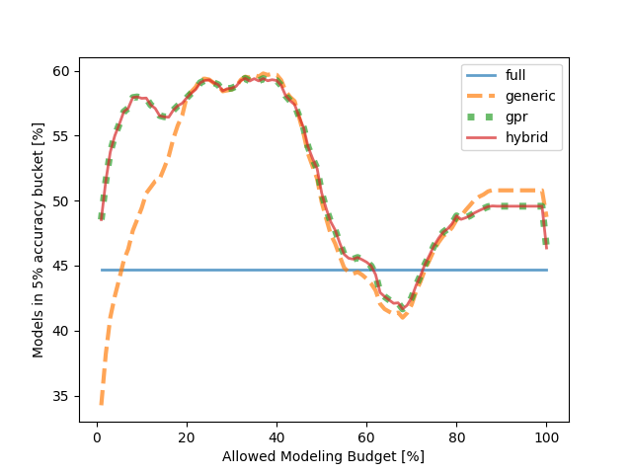
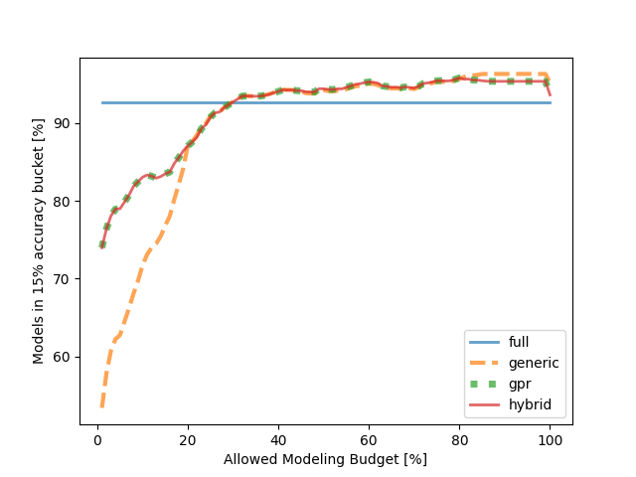
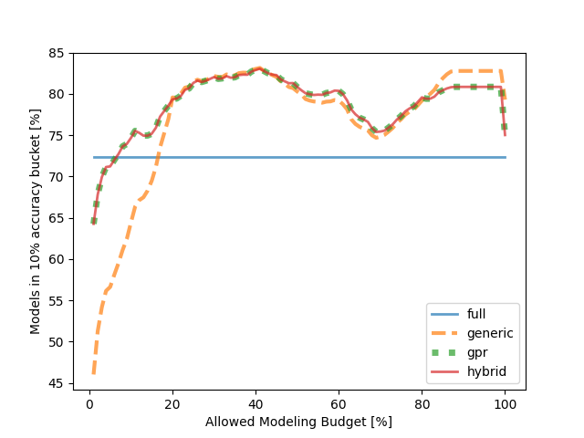
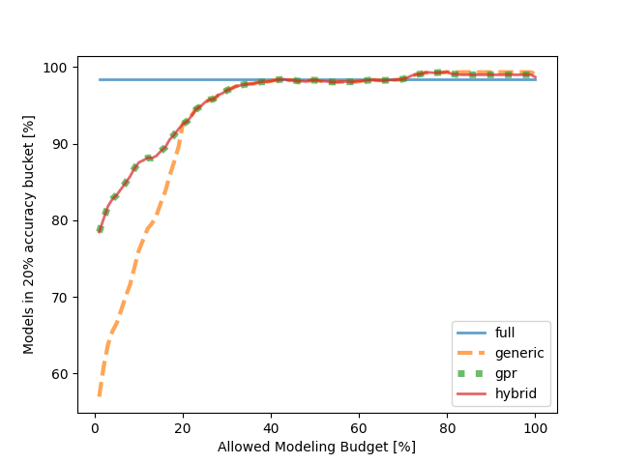
Synthetic Evaluation – Model Accuracy 2 Model Parameter & 10% Noise
The GPR, hybrid strategy outperform the generic strategy using small modeling budgets <20%
The turning point is always at about 20% modeling budget
5% Accuracy Bucket
15% Accuracy Bucket
The bigger the accuracy bucket, the better the model accuracy for all strategies
10% Accuracy Bucket
20% Accuracy Bucket
For more than 25% budget the gpr, generic, and hybrid strategy perform identically
The bigger the accuracy bucket, the more the GPR, hybrid strategy outperforms the generic strategy

Slide 15

Synthetic Evaluation – Model Cost 2 Model Parameter & 10% Noise
The GPR, hybrid strategy always use the same model cost as the genneric strategy

Slide 16
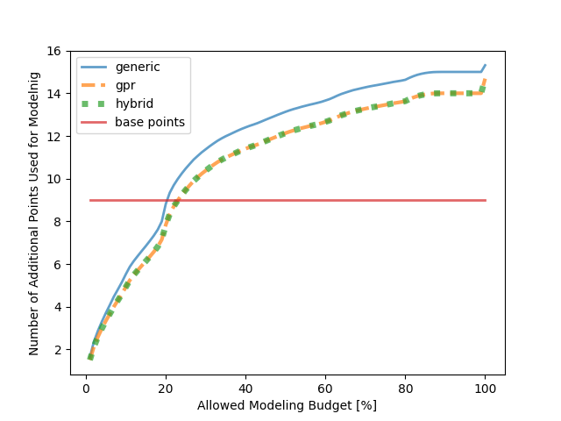
Synthetic Evaluation – Selected Points 2 Model Parameter & 10% Noise
The generic strategy uses consistently more measurement points than the GPR, hybrid strategy for all budget levels
The GPR an hybrid approach use the same amount of additional points for modeling
Considering the used budget, the GPR, hybrid strategy use less but more expensive points
The more expensive points provide better insights, which leads to a higher model accuracy

